Slide 1
Time-series electron diffraction data analysis
By John Feng
Demonstration of Data Science skills for Ph.D. project

Slide 2
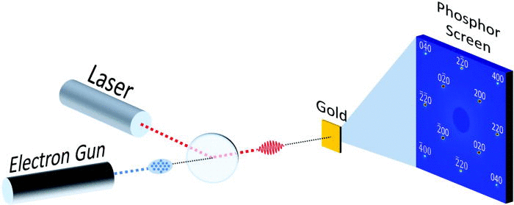
What is Ultrafast Electron Diffraction?
Ultrafast electron diffraction is a technique used to probe the time-series structural dynamics of molecular samples. In essence, an ultrafast electron pulse illuminates a diffractive sample, then we can interpret its structure changes by analyzing the resultant diffraction pattern. The reaction of the sample is initiated by an ultrafast laser pulse. By varying the delay time between the electron pulse and laser pulse, we can capture enough diffraction images to make a “movie” of the ensuing structure changes.
This presentation will focus on the data analysis aspect of this project.

Slide 3
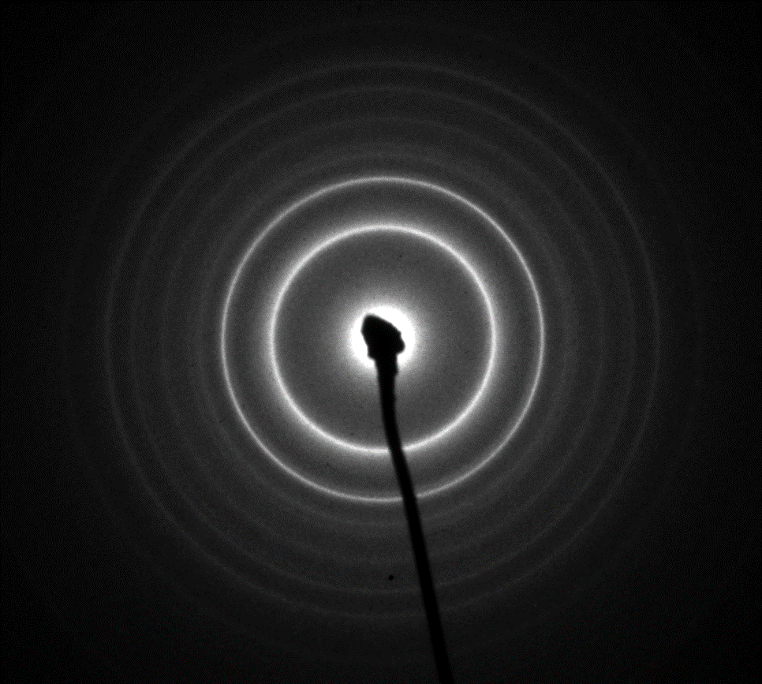
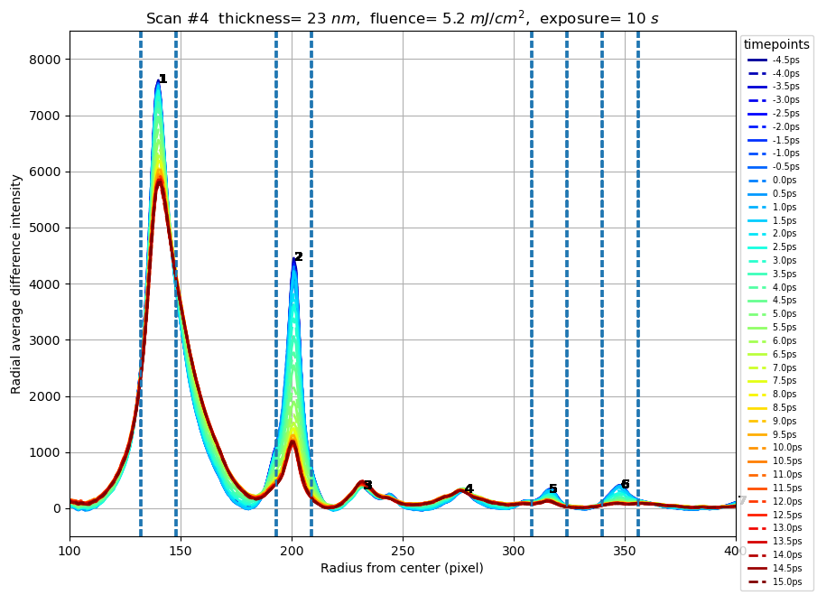
Diffraction image processing
2 ps
1 ps
0 ps
1 ps
-1 ps
In this project, we are specifically investigating the ultrafast melting of bismuth metal. This project involves processing and analyzing a series of electron diffraction images of polycrystalline bismuth. The goal is to find the speed and response time of its melting process.
First, we must process the 2D diffraction images into usable data. We do that by performing a radial average of the diffraction pattern, which is stored in TIFF image files. This is done with two main steps:
Find the center of the diffraction pattern
Integrate the intensity of the pixels in the radial axis

Slide 4
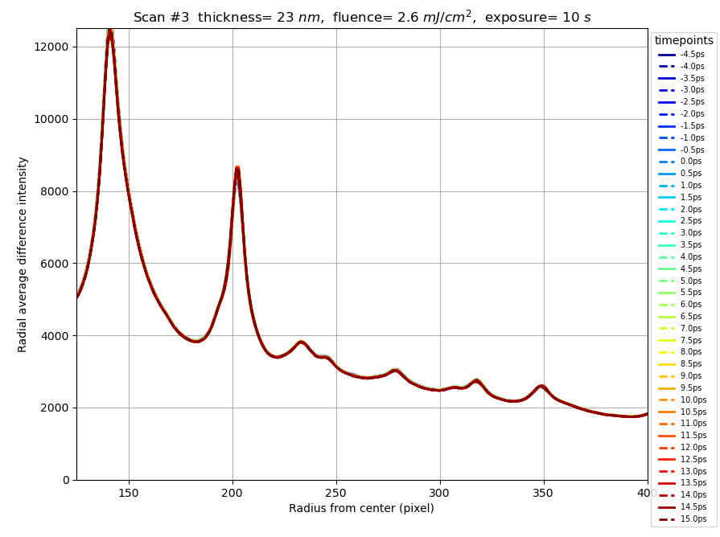
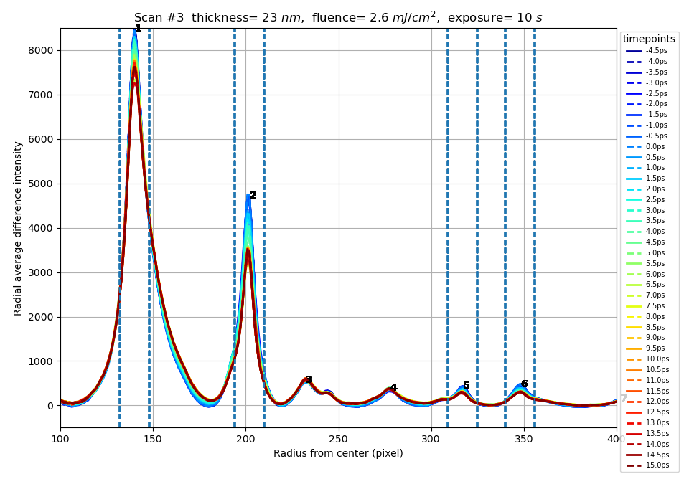
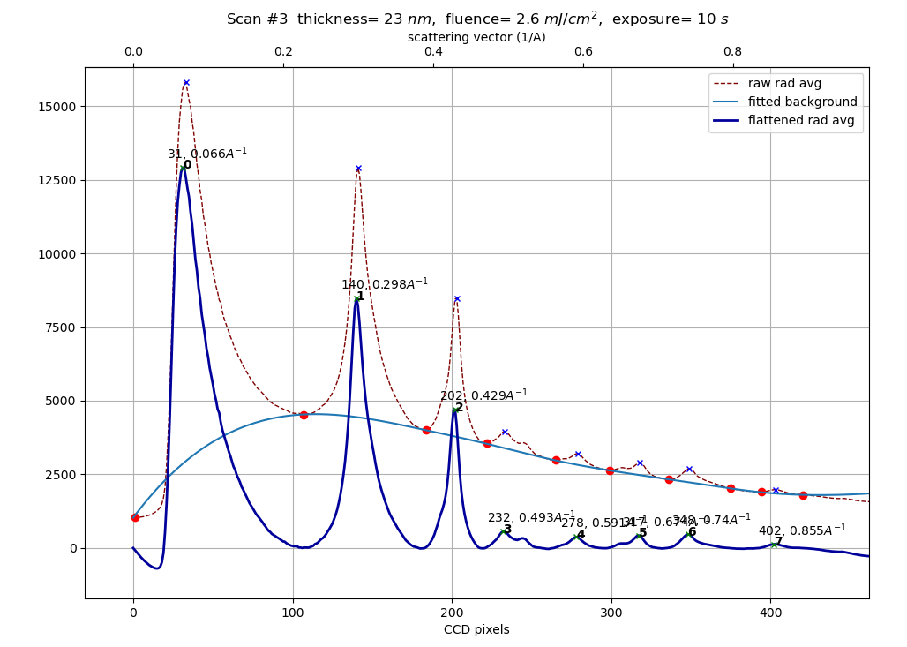
Processing background
Original
Background subtracted
We must also deal with background noises. In capturing the diffraction pattern, there is unwanted background light (noise) that distorts the signal data.
The first step is to subtract the background image captured by the camera from the raw diffraction image. Then from the radial average, we computationally flattened the background using signal processing tools from Scipy.
Flattening process
https://docs.scipy.org/doc/scipy/reference/generated/scipy.signal.find_peaks.html

Slide 5
Organization of data
Sample is the specific sample we studied. The samples are different by the thickness of the Bi layer.
Fluence is the laser power used to trigger the sample in the experiment.
Diffraction peak refers to the specific ring of the diffraction pattern
Timepoints are the time delay between pump and probe, usually plotted on the x-axis.
Sample
Fluence
Diffraction Peak
Timepoints

Slide 6
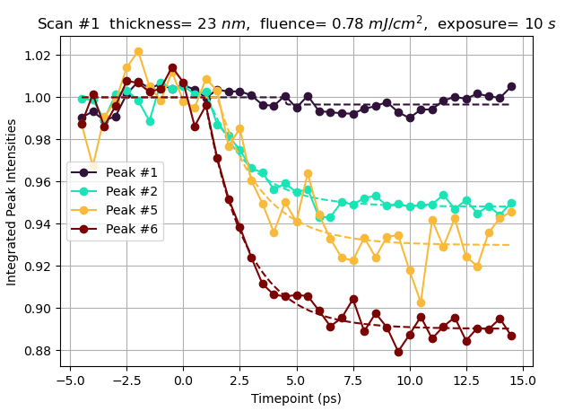
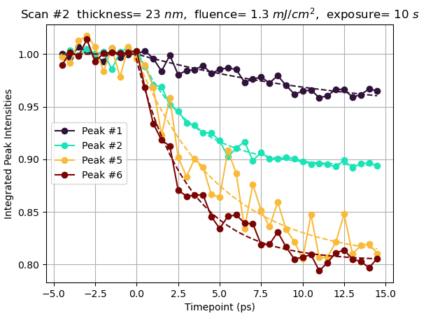
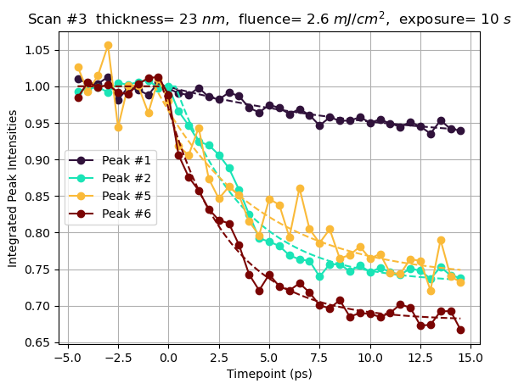
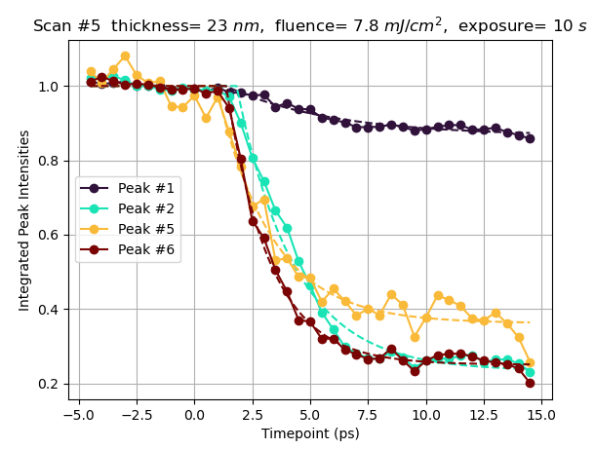
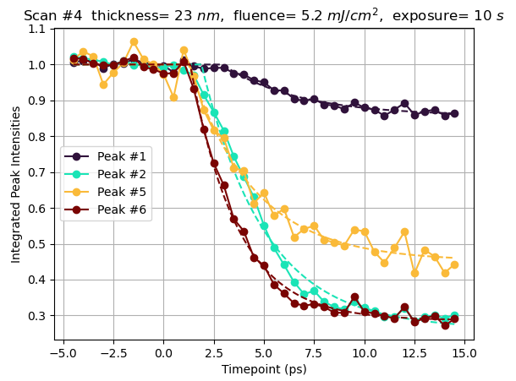
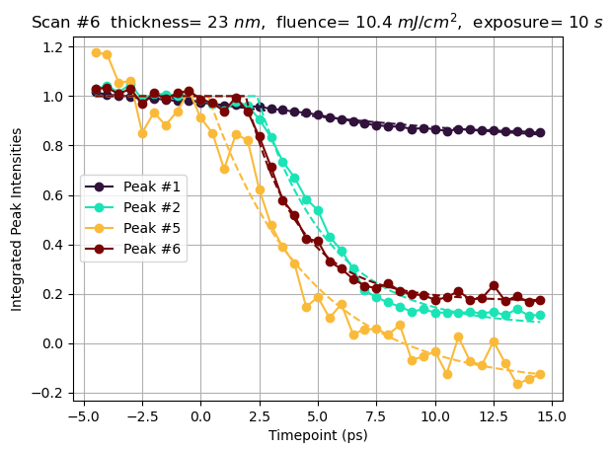
Data Visualization We look at the decay of peak intensities for each fluence

Slide 7
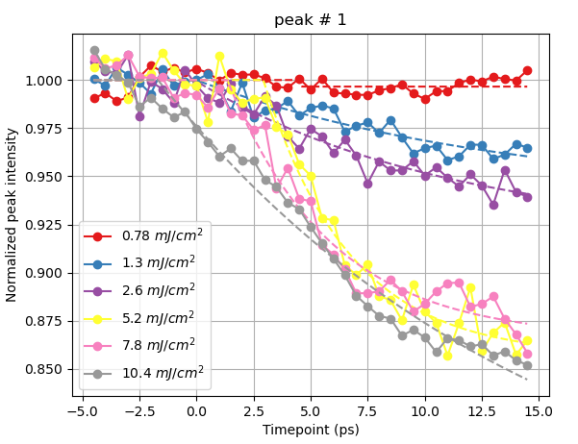
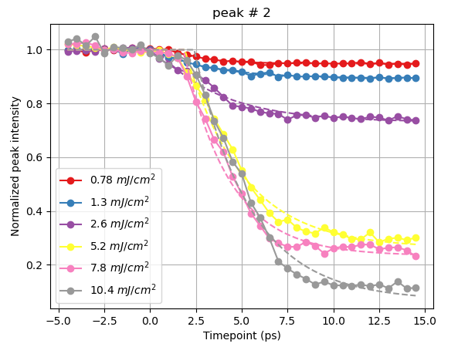
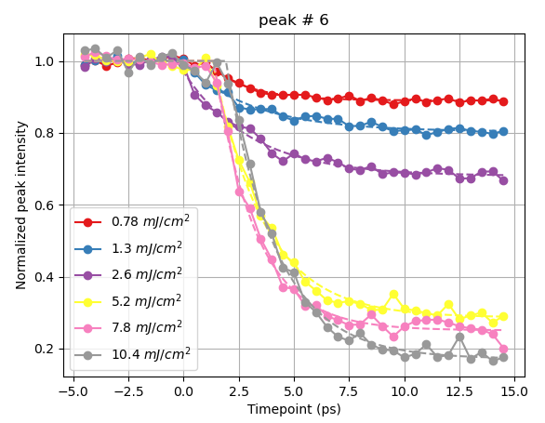
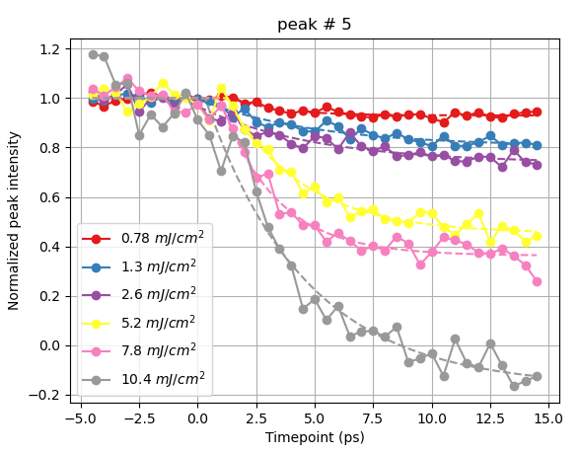
Same data, plotted differently. Looking at the effect of fluence on each peak

Slide 8
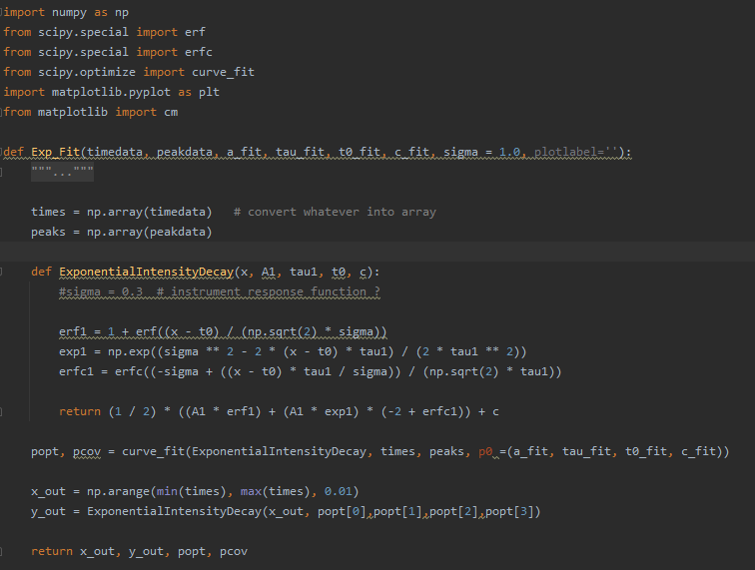
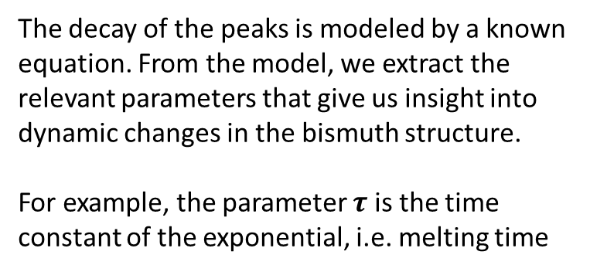
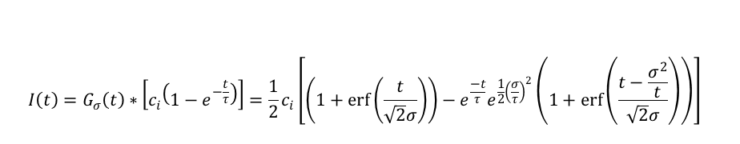
Model fitting
$$I\left(t\right)=G_{σ}\left(t\right)∗\left[c_{i}\left(1−e^{−\frac{t}{τ}}\right)\right]=\frac{1}{2}c_{i}\left[\left(1+\operatorname{erf}\left(\frac{t}{\sqrt{2}σ}\right)\right)−e^{\frac{−t}{τ}}e^{\frac{1}{2}{\left(\frac{σ}{τ}\right)}^{2}}\left(1+\operatorname{erf}\left(\frac{t−\frac{σ^{2}}{t}}{\sqrt{2}σ}\right)\right)\right]$$
Exact equation
The decay of the peaks is modeled by a known equation. From the model, we extract the relevant parameters that give us insight into dynamic changes in the bismuth structure.
For example, the parameter $τ$ is the time constant of the exponential, i.e. melting time
Parameters for model fit
Connected lines represent raw data
Dashed line is the model fit

Slide 9
Tools used
Standard Python data manipulation libraries
Numpy - for certain math operations and dealing with arrays
Pandas - DataFrames are essential for this analysis
Scipy - curve fit and certain image processing tools
Sqlalchemy - exporting and query the data from a SQL server into Pandas dataframes
PostgresSQL server for storing and organizing data
Tableau for quick visualization of data

Slide 10
Thanks for listening ☺
Here is the GitHub of all the code used in this project
https://github.com/johnnykfeng/Bismuth-Data-Analysis-github/tree/working-branch
P.S. it’s not very organized or well documented

